Slide 1

Preventing customer churn
At-Risk Customers at SyriaTel
SHEILLA KAVINYA MULI

Slide 2

Need to know
The problem: Customer retention is cheaper than acquisition. Losing customers cost SyriaTel revenue and market share
The goal: Move from reactive (fixing problem after they leave) to proactive (identifying risk before they leave)
The solution: A predictive model to flag high risk customers,

Slide 3
BUSINESS AND DATA UNDERSTANDING
Data Sources : Analyzed records of 3335 customers
What was looks at
Usage(Day/Night minutes)
Customer Service interactions
Plan details (International, voicemail)
The big concern: Can we find a pattern in the behavior of customers who left?

Slide 4
MODELING
The model was a churn classifier.
The model was fed the model historical data of customers who stayed vs the ones who left.
Learning: The model learned the fingerprint of a churner
The model was then tested it on unseen data to ensure reliability.

Slide 5
EVALUATION (PERFORMANCE)
Accuracy: The model correctly identifies customer status 88% of the time
Key metric(Recall): Crucially, it catches 99% of the customers who are actually about to leave
Business impact: By using this model, we can intervene with potential churners we would have otherwise missed

Slide 6
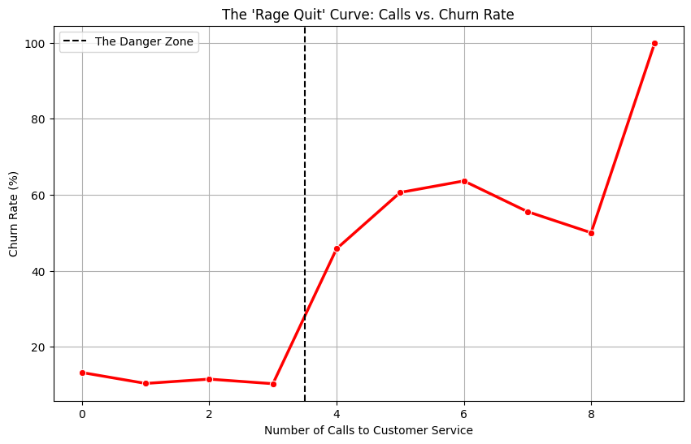
KEY INSIGHTS
Customers with international plans but no voicemail leave at a high rate
Customers who call customer service more than 3 times are highly likely to churn

Slide 7

RECOMMENDATIONS
The service recovery protocol: Automatically flag any customer who calls support a 3rd time for a “VIP supervisor” follow up
Targeted offers: Create a specialized international bundle that includes voicemail to reduce friction for international travelers
Proactive outreach: Send retention offers to high usage customers before their contract renewal date.

Slide 8
NEXT STEPS
Integrate this model into the Call Center dashboard (to provide real time alerts)
Collect data on the reason for a client leaving (price vs service) to refine the model
Run an A/B test: offer a discount to the flagged group and measure how many stay

Slide 9
Thank you

